Slide 1


Gujjari Lakshmi Priyanka
2nd November 2021

Slide 2


Outline
Executive Summary
Introduction
Methodology
Results
Conclusion
Appendix

Slide 3

Executive Summary
Summary of methodologies
Data Collection via API, SQL and Web Scraping
Data Wrangling and Analysis
Interactive Maps with Folium
Prediction Analysis using Classification Models
Summary of all results
Data Analysis along with Interactive Visualizations
Best model for Prediction Analysis

Slide 4

Introduction
Project background and context
SpaceX is perhaps the most successful space company.
The reason for SpaceX's success is its inexpensive rocket launches.
SpaceX advertises Falcon 9 rocket launches on its website with a cost of 62 million dollars; other providers cost upwards of 165 million dollars each.
The reason for its cost saving is its reusable first stage.

Slide 5
In this project, we are working for a new rocket company, SpaceY that would like to compete with SpaceX.
Our job as a data scientist is to determine the price of each launch.
Instead of using rocket science, we are going to build a machine learning model and use public information to predict if SpaceX will reuse the first stage.
Problems you want to find answers
What factors play a role in the rocket’s successful landing?
The effect of the various rocket variables on the outcome
Conditions that aid SpaceX to achieve best results.

Slide 6


Slide 7

Methodology
Data Collection Methodology
Using SpaceX REST API
Web Scrapping from Wikipedia
Data Wrangling
Dropping irrelevant columns
One-hot encoding data fields for Model building
Exploratory Data Analysis
Using SQL
With Data Visualizations
Interactive Visual Analytics
Using Folium and Plotly Dash Visualizations
Predictive Analysis
Build and evaluate different Classification models

Slide 8
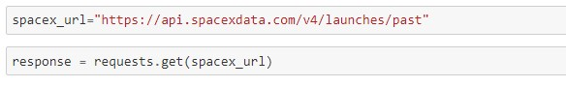
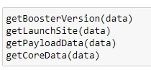
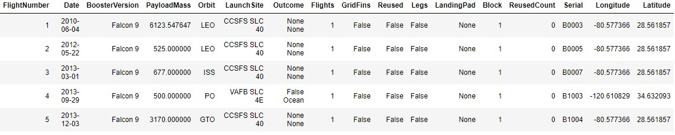
Data Collection – SpaceX API
GitHub: Data Collection
Request rocket launch data from SpaceX API
Apply custom functions to clean data
Filter data frame to include only Falcon9 launches

Slide 9
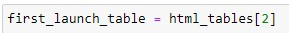
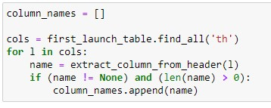
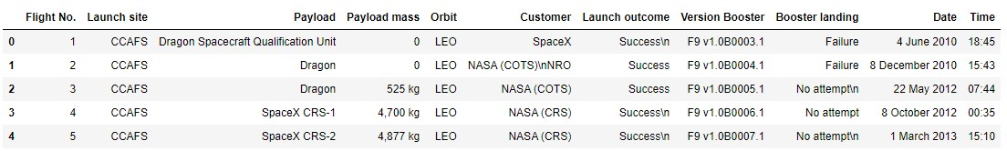
Data Collection – Web Scraping
GitHub: Data Collection with Web Scraping
Getting Response from HTML
Creating Beautiful Soup Object
Finding Tables
Getting columns
Creation of dictionary and appending data
Converting dictionary to dataframe
Dataframe to .CSV

Slide 10
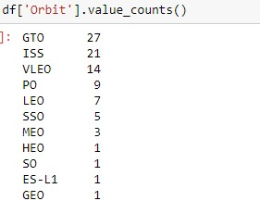
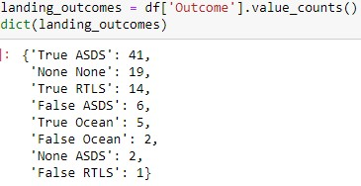
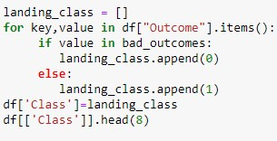
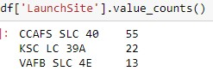
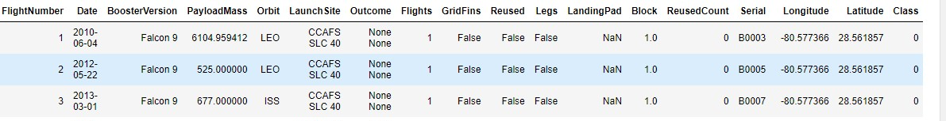
We are going to convert the mission launch outcomes into Training labels with1 means booster landed successfully and 0 means unsuccessful landing.
Data Wrangling
GitHub: Data Wrangling
Calculate number of launches at each site
Calculate number and occurrence of each orbit
Calculate number and occurrence of mission outcome per each orbit
Create landing outcome label from outcome column

Slide 11
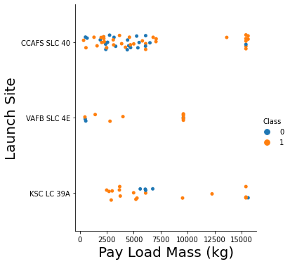
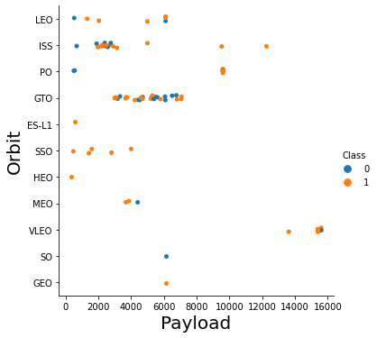
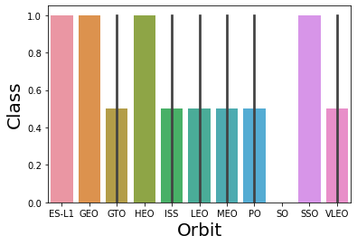
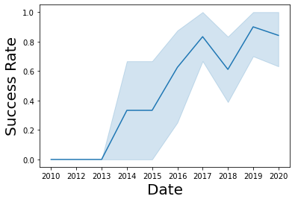
EDA with Data Visualization
GitHub: EDA with Visualization
Scatter Plots Drawn
Payload and Flight Number
Flight Number and Launch Site
Payload and Launch Site
Flight Number and Orbit Type
Payload and Orbit Type
Bar Graph Drawn
Success Rate vs Orbit Type
Line Graph Drawn
Launch Success Yearly Trend

Slide 12
Here we use the IBM’s Db2 for Cloud, which is a fully managed SQL database provided as a service.
EDA with SQL
GitHub: Data Analysis with SQL
Summary of the SQL queries performed
Display the names of the unique launch sites in the space mission
Display 5 records where launch sites begin with the string 'CCA'
Display the total payload mass carried by boosters launched by NASA (CRS)
Display average payload mass carried by booster version F9 v1.1
List the date when the first successful landing outcome in ground pad was achieved.
List the names of the boosters which have success in drone ship and have payload mass greater than 4000 but less than 6000
List the total number of successful and failure mission outcomes
List the names of the booster_versions which have carried the maximum payload mass
List the failed landing outcomes in drone ship, their booster versions, and launch site names for in year 2015
Rank the count of landing outcomes (such as Failure (drone ship) or Success (ground pad)) between the date 2010-06-04 and 2017-03-20, in descending order

Slide 13
Build an Interactive Map with Folium
GitHub: Data Visualization with Folium
Folium makes it easy to visualize data that’s been manipulated in Python on an interactive leaflet map.
We used the latitude, longitude of each launch site and added a circle marker around each launch site with a label of its name.
We also visualized the success and failure of the launches on each site using reg and green markers
MAP OBJECT | CODE | RESULT
MAP MARKER | folium.Marker( | Map object to make a mark on map
ICON MARKER | folium.Icon( | Create an icon on map
CIRCLE MARKER | folium.Circle( | Create a circle where marker is placed
POLYLINE | foluim.PolyLine( | Create a line between points
MARKER CLUSTER OBJECT | MarkerCluster() | To simplify a map with many markers at same point
ANT PATH | folium.plugins.AntPath( | Create an animated line between points

Slide 14
Build a Dashboard with Plotly Dash
Github: Dashboard
Piechart showing the total success for all sites or by certain launch.
Scatter Graph showing the correlation between success and payload for all sites or by certain launch site.

Slide 15
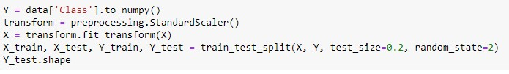
Predictive Analysis (Classification)
GitHub: ML Prediction Analysis
Building Model
Load our feature engineered data into dataframe
Transform it into Numpy arrays
Standardize& transform data
Split data into training and test datasets
Check how many test samples have been created
List down machine learning algorithms to use
Set our parameters and algorithms to GridSearchCV
Fit our datasets into the GridSearchCV object and train the model
Evaluating Model
Check accuracy of each model : Logistic Regression, SVM and Decision Tree Classifier
Get best hyperparameters for each algorithm
Plot confusion matrix
Finding Best Performing Classification model
The model with the best accuracy score is the best Classification model

Slide 16
Results
Exploratory data analysis results
Interactive analytics demo in screenshots
Predictive analysis results

Slide 17


Slide 18
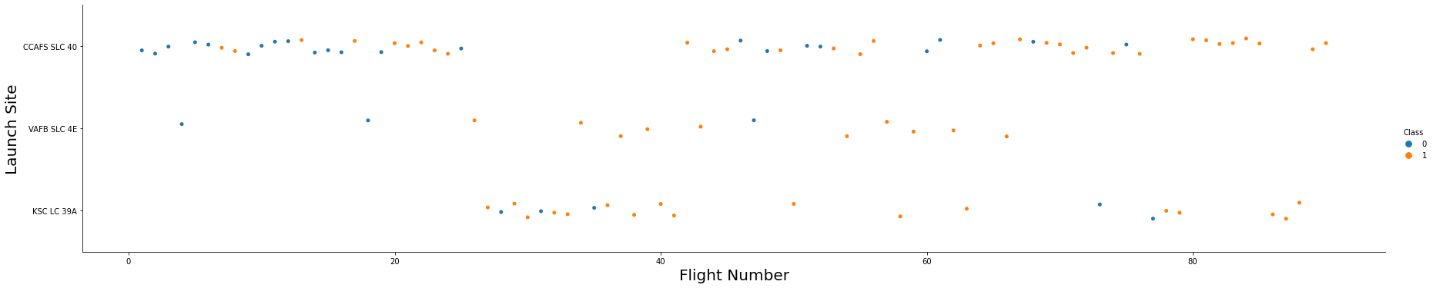
Flight Number vs. Launch Site
Scatter plot of Flight Number vs. Launch Site
With Higher flight numbers (greater than 30) the success rate for the rocket increases

Slide 19
Payload vs. Launch Site
Scatter plot of Payload vs. Launch Site
With a greater payload (>7000kg) there is a greater scope for success of the launch.

Slide 20
Success Rate vs. Orbit Type
Bar chart for the success rate of each orbit type
ES-L1, GEO, HEO, SSO have the highest success rate.

Slide 21
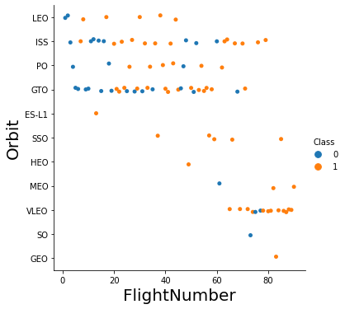
Flight Number vs. Orbit Type
Scatter point of Flight number vs. Orbit type
We see that for LEO orbit success rate increases with the increase in Flight number
On the other hand, there seems to be no relation between the Flight number and orbit type for GTO orbit

Slide 22
Payload vs. Orbit Type
Show a scatter point of payload vs. orbit type
We observe that heavy loads have a negative impact on MEO, GTO and VLEO orbits.
Positive impact on ISS and LEO orbits

Slide 23
Launch Success Yearly Trend
Line chart of yearly average success rate
The success rate increased relatively since 2013 till 2020 although it took a slight dip in 2019.

Slide 24
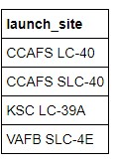
All Launch Site Names
Names of the Launch Sites
Using the word DISTINCT will pull the unique values of a particular column in the table
Here the column is `launch_site` and the table is `SPACEXDATASET`

Slide 25
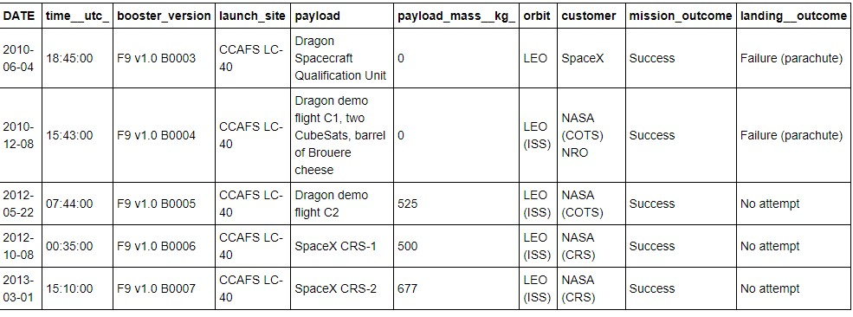
Launch Site Names Begin with 'CCA'
5 records where launch sites begin with `CCA`

Slide 26
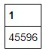
Total Payload Mass
Total payload carried by boosters from NASA
Using the function SUM calculates the total of the column and WHERE clause filters the data to meet the required condition.
Here the column is `PAYLOAD_MASS_KG_ and the table is SPACEXDATASET while the clause is NASA

Slide 27
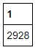
Average Payload Mass by F9 v1.1
Average payload mass carried by booster version F9 v1.1
The function AVG calculates the average of the column and the where clause is used to filter the data according to the required condition.
The column is PAYLOAD_MASS_KG_, table is SPACEXDATASET and the condition is BOOSTER_VERSION F9 v1.1

Slide 28
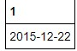
First Successful Ground Landing Date
The dates of the first successful landing outcome on ground pad
The function MIN is used to find the minimum of the column in a table and the WHERE clause is used to filter the data according to the given condition

Slide 29
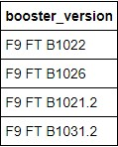
Successful Drone Ship Landing with Payload between 4000 and 6000
The names of boosters which have successfully landed on drone ship and had payload mass greater than 4000 but less than 6000

Slide 30
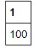
Total Number of Successful and Failure Mission Outcomes
The total number of successful and failure mission outcomes
The function COUNT is used to numerically count the values according to the conditions satisfied in the WHERE clause

Slide 31
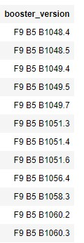
Boosters Carried Maximum Payload
The names of the booster which have carried the maximum payload mass

Slide 32
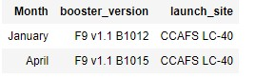
2015 Launch Records
The failed landing_outcomes in drone ship, their booster versions, and launch site names for in year 2015

Slide 33
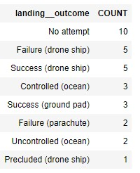
Rank Landing Outcomes Between 2010-06-04 and 2017-03-20
The count of landing outcomes (such as Failure (drone ship) or Success (ground pad)) between the date 2010-06-04 and 2017-03-20, in descending order

Slide 34


Slide 35
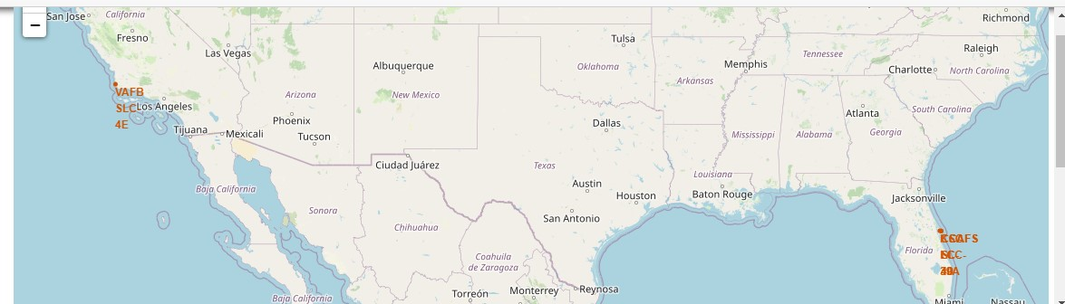
Folium map showing all the launch sites
Explain the important elements and findings on the screenshot

Slide 36
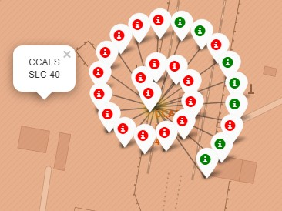
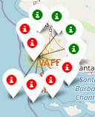
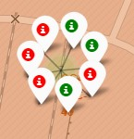
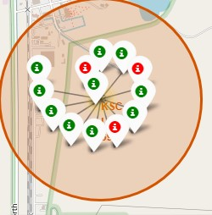
Folium maps showing Success and failure launches at each site
The green icons indicate success and the red icons indicate failure
CCAFS LC-40
VAFB SLC-4E
CCAFS SLC-40
KSC LC-39A

Slide 37
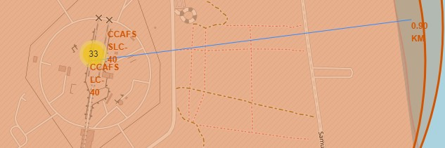
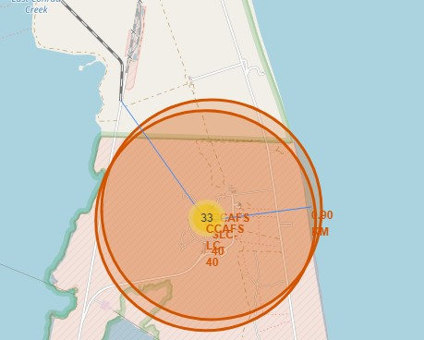
Folium Map showing distance to nearest places
Folium map showing the distance between the launch site and the coast line
Folium map showing the distance between the launch site
and the nearest railway line- it is about 0.7km

Slide 38


Slide 39
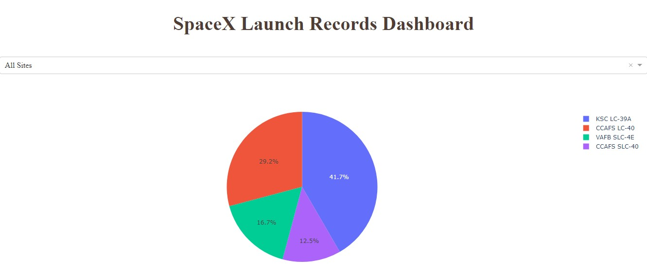
Launch Success Count of All Sites
KSC LC-39A is the launch site with the maximum successful launches of all the sites.

Slide 40
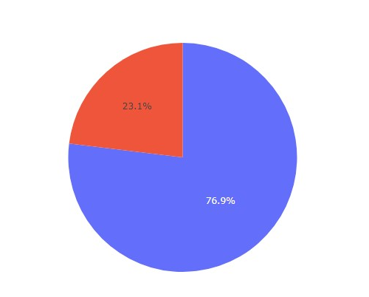
KSC LC-39A Success Rate
KSC LC-39A achieved a success rate of 76.9%
Insights obtained by visualizing the dashboard:
Which site has the highest launch success rate?
KSC LC-39A
Which payload ranges have the highest success rate?
2000kg to 10000kg
Which payload ranges have the lowest success rate?
0 to 2000kg
Which F9 booster version has the highest success rate?
FT

Slide 41
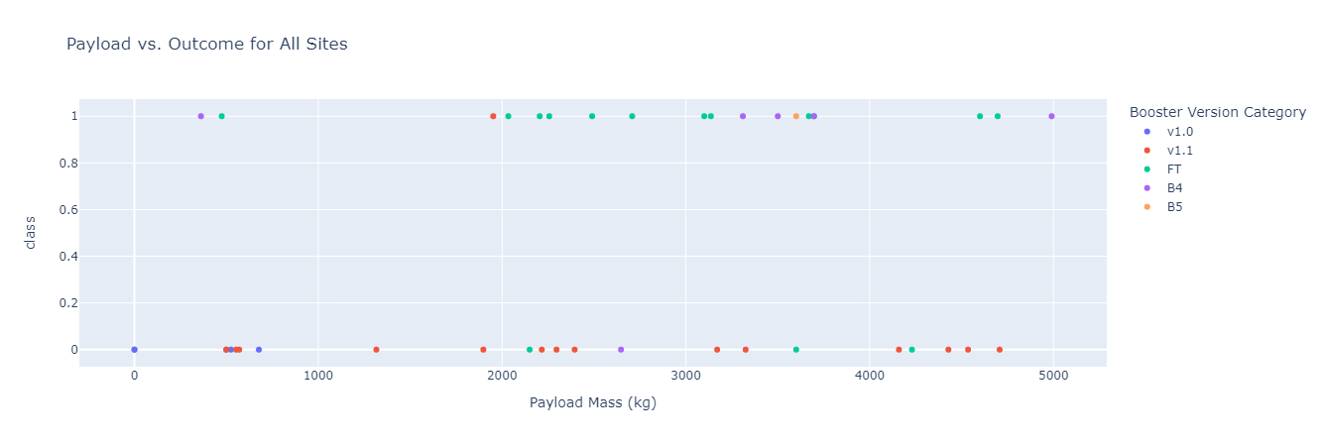
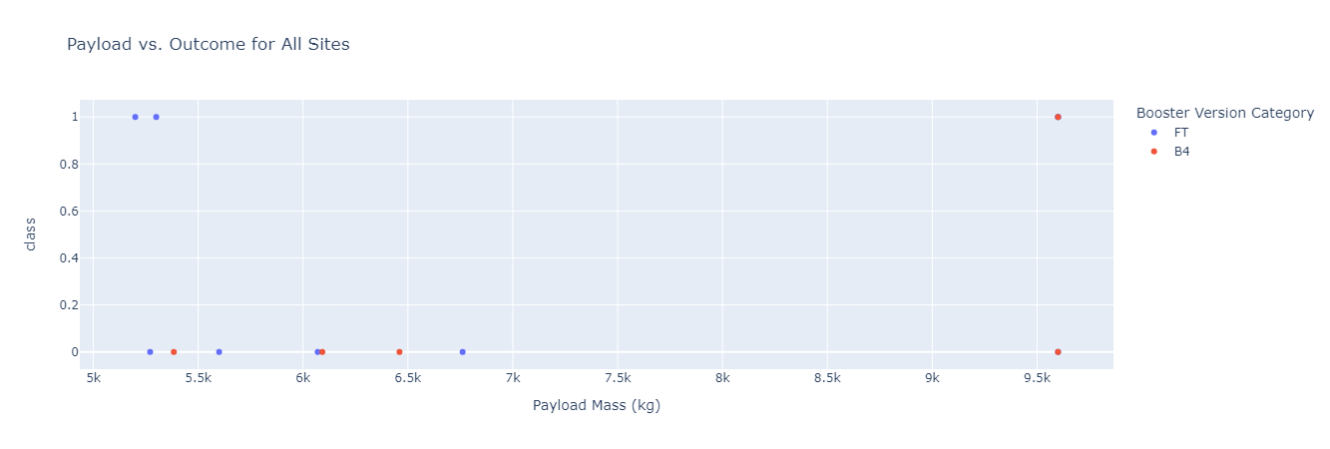
Scatter Plots for Payload vs Outcomes
The success rate for low weighted payloads is higher than for that of higher payloads.
Low Payloads 0-5000kg
High Payloads 5000kg -10000 kg

Slide 42


Slide 43
Classification Accuracy
ALGORITHM | ACCURACY | ACCURACY (TEST DATA) | TUNED HYPERPARAMETERS
LOGISTIC REGRESSION | 0.84643 | 0.8334 | 'C': 0.01, 'penalty': 'l2', 'solver': 'lbfgs'
SVM | 0.84821 | 0.8334 | 'C': 1.0, 'gamma': 0.03162277660168379, 'kernel': 'sigmoid'
KNN | 0.84821 | 0.8334 | 'algorithm': 'auto', 'n_neighbors': 10, 'p': 1
DECISION TREE | 0.88571 | 0.8334 | 'criterion': 'gini', 'max_depth': 12, 'max_features': 'sqrt', 'min_samples_leaf': 4, 'min_samples_split': 2, 'splitter': 'random'
Almost all the models have same accuracy levels although Decision Tree model has a greater accuracy on Training data

Slide 44
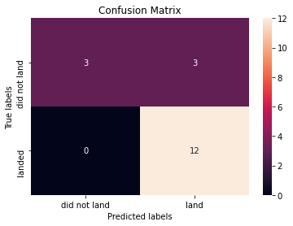
Confusion Matrix
LOGISTIC REGRESSION
SVM
All the four models have the same confusion matrix unfortunately.
DECISION TREE
KNN

Slide 45
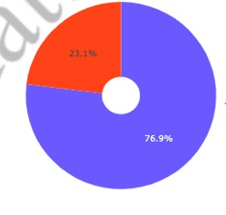
Conclusions
Orbits ES-L1, GEO, HEO, SSO have higher success rates.
Success rates for SpaceX launches has been increasing almost consistently and would reach the required target in the future.
KSC LC-39A had the most successful launches but increasing payload seems to have a negative impact on the success rate.
Based on the accuracy results, Decision Tree Classification algorithm can be best suited ML model for this dataset
KSC LC-39A

Slide 46


